Slide 1

AIS421: NLP Applications
Hieroglyphics Translation System
Using Large Language Model

Slide 2
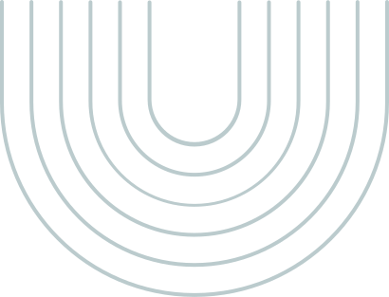
Problem
Ancient Egyptian hieroglyphs, one of the oldest writing systems, are challenging to decipher due to their complex symbols, multiple writing directions, and lack of spaces between words.
Understanding them typically requires rare and expensive Egyptologists, making it difficult for tourists and researchers to access this ancient knowledge.
To bridge this gap, there is a need for an automated solution that can accurately detect, classify, and translate hieroglyphs into modern languages like English, making ancient texts more accessible to everyone.

Slide 3
Gardiner’s Code System
Structure:
Alphanumeric codes (e.g., "A" for human figures, "B" for body parts).
Bridges visual glyphs to linguistic meanings.
Role in this study:
Serves as the foundational dataset for mapping hieroglyphs to English.

Slide 4
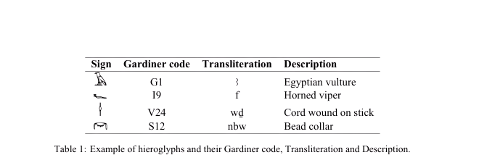
Dataset
Dataset Structure
Two Key Components:
Input: Gardiner codes (symbolic representation).
Example: ["G1", "D4", "Y1"]
Output: English translations (words/phrases).
Example: ["vulture", "hand", "bread loaf"]
Format:
CSV file with columns: Gardiner_Code, English_Translation.
Preprocessed to remove noise (e.g., non-English text, metadata).

Slide 5
Dataset Preprocessing
Cleaning Steps:
Remove non-English text:
Eliminated German/French annotations (e.g., "Keine Übersetzung vorhanden").
Strip metadata:
Removed brackets/parentheses (e.g., <Beischrift>, [Zusatzelement]).
Normalize whitespace/punctuation:
Unified spaces, removed redundant symbols.

Slide 6
Limitation of Dataset
Limited Coverage
Missing Context
Bias Toward Common Glyphs
Only includes Gardiner’s 700 symbols (not exhaustive).
Missing rare or context-dependent glyphs.
Problem: The dataset translates single symbols, not full sentences.
Example:
Input: ["G1", "D4"] → Output: ["vulture", "hand"]
But in a real text, these might mean "protection of the king" (not just "vulture hand").
Problem: Some symbols (like "G1") appear very often in the dataset, while others are rare.
Impact: The AI is better at translating frequent symbols but struggles with rare ones.

Slide 7
Computer Vision (CV) Pipeline – From Images to Codes

Slide 8
COMPUTER VISION (CV) PIPELINE – FROM IMAGES TO CODES
STEP 1
STEP 2
STEP 3
Detect hieroglyphs in images (e.g., temple walls).
Classify each glyph using InceptionV3 (97% accuracy!).
Output Gardiner codes (e.g., "G1") for NLP translation.

Slide 9




HIEROGLYPHIC TRANSFORMER ARCHITECTURE
1. Core Model: M2M-100 Multilingual Transformer
2. Key Adaptations for Hieroglyphs
Input Representations:
Gardiner Codes (e.g., G1 D4 Y1) → Symbolic input.
Transliteration (e.g., r.kwj tw) → Phonetic input.
Special Tokens:
Language IDs: ar (Arabic) for Egyptian, lo (Lao) for transliteration, th (Thai) for POS tags.
Pretrained on 100 modern languages (including English/German).
Uses encoder-decoder structure with attention mechanisms.
5. Evaluation Metrics
Automatic:
SacreBLEU (54.4 for egy→de) → Measures n-gram overlap.
ROUGE-L (64.5 for egy→de) → Assesses sentence structure.
3. Training Pipeline
Data Pairing:
Sources: egy (Gardiner codes) or τ (transliteration).
Targets: German (de), English (en), transliteration (τ), lemma IDs, POS tags.
Backtranslation:
Augmented English data by translating German → English with M2M-100.
Hyperparameters:
Batch size: 16, Learning rate: 3e-5, Adam optimizer.
Early stopping if no improvement after 15–20 evaluations.
4. Multi-Task Learning
Simultaneous Training:
Hieroglyph → German/English.
Hieroglyph → Transliteration.
Hieroglyph → Lemma IDs/POS tags.
Benefit: Shared representations improve translation accuracy.

Slide 10
Natural Language Processing (NLP) Pipeline – From Codes to English

Slide 11


NLP PIPELINE – FROM HIEROGLYPHIC CODES TO ENGLISH
1.
Input Representations
2.
3.
Training Process
Model Architecture
Gardiner Codes (Symbolic Input)
Transliteration (Phonetic Input)
Base Model: M2M-100 Transformer (Fan et al., 2021).
Pretrained on 100 languages (transfer learning).
Encoder-decoder with cross-attention.
Key Steps:
Backtranslation: German→English to augment scarce English data.
Fine-Tuning: 6–20 epochs (early stopping).
Hyperparameters:
Batch size: 16, Learning rate: 3e-5 (Adam optimizer).

Slide 12
Thank you

